Slide 1
Linking Lists
Speaker: Michael Liang

Slide 2
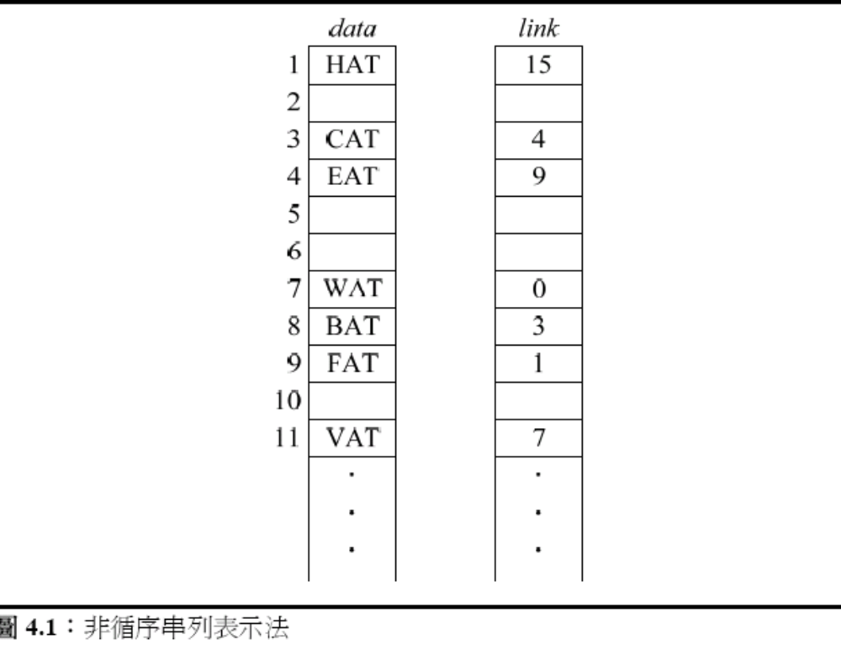
Linking lists

Slide 3
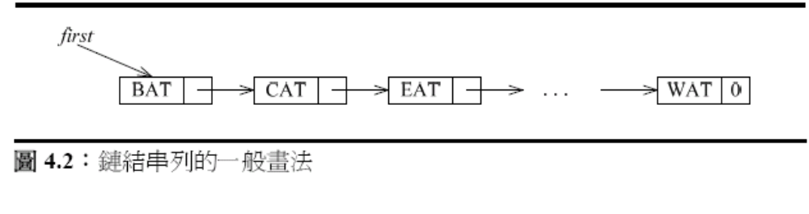
Linking lists

Slide 4
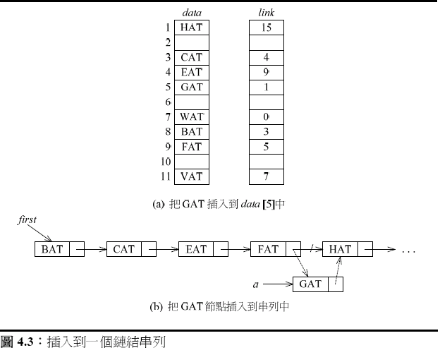
Linking lists: insert

Slide 5
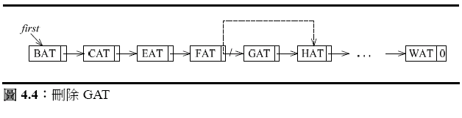
Linking list: delete

Slide 6
Representation
typedef struct listNode *listPointer;
  typedef struct listNode{
  char data[4];
  listPointer link;
  }
  listPointer first =NULL;
  #define ISEMPTY(first) (!(first))
  MALLOC(first, sizeof(*first));
  strcopy(first->data, “BAT”);
  first->link = NULL;

Slide 7
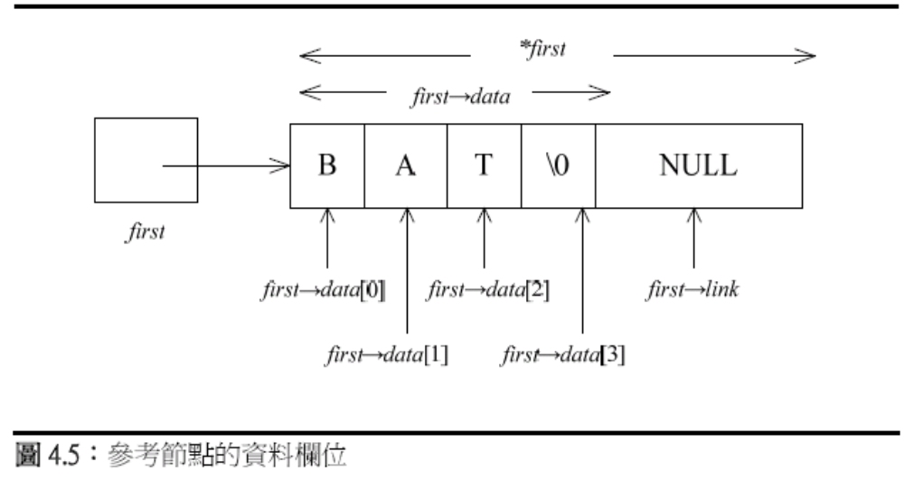
Representation

Slide 8
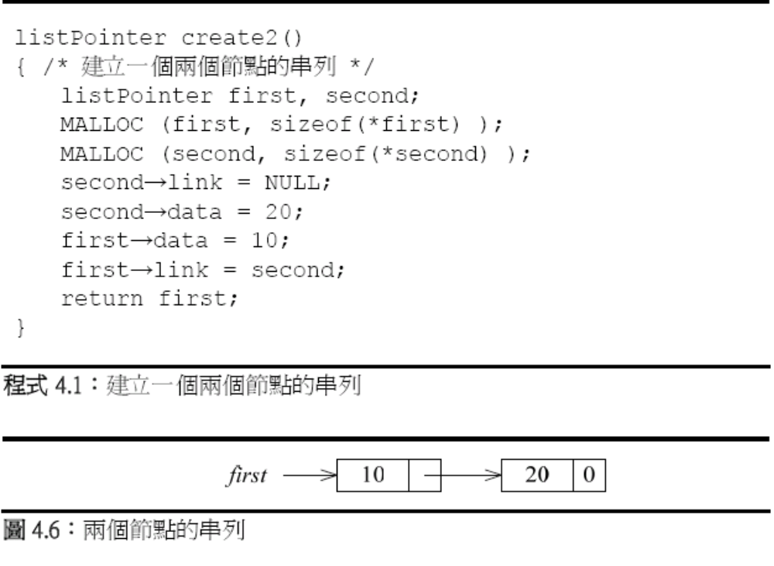
Linking list

Slide 9
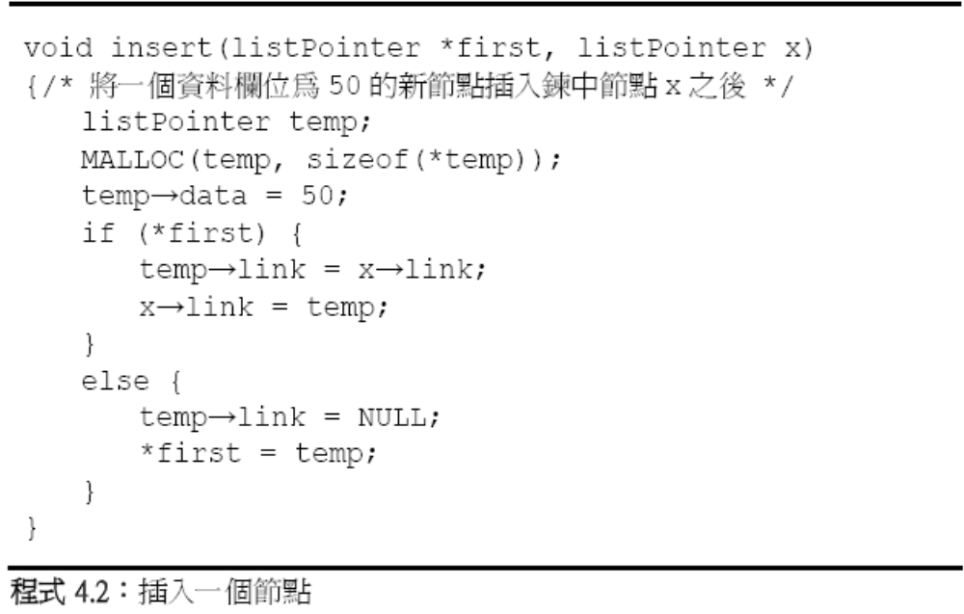
Linking list

Slide 10
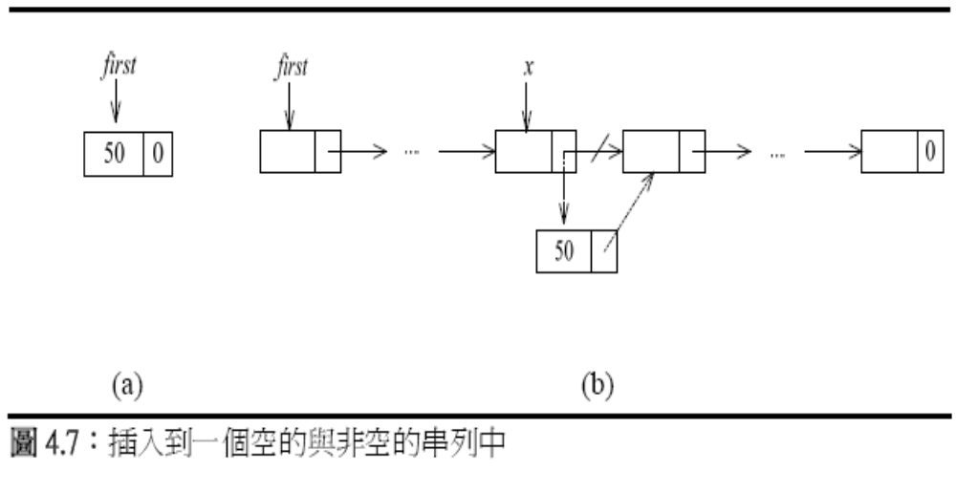
Linking list : insert

Slide 11
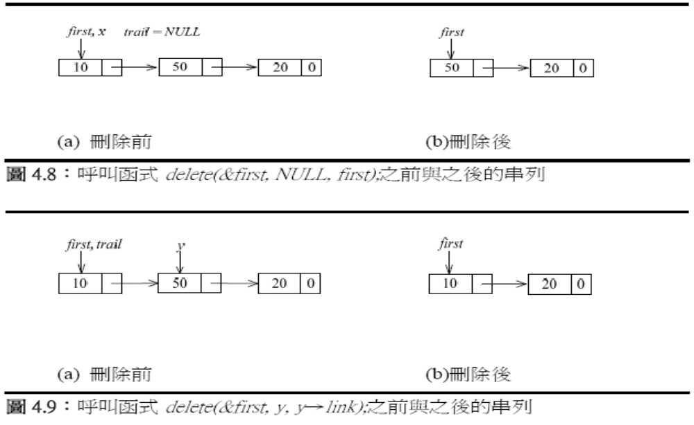
Linking list : delete

Slide 12
Linking list
void delete(listPointer *first, listPointer trail,
listPointer x)
{
/* 將x從串列中刪除，trail是x的前一個節點
*first是串列的開頭 */
if (trail)
trail→link = x→link;
else
*first = (*first)→link;
free(x);
}

Slide 13
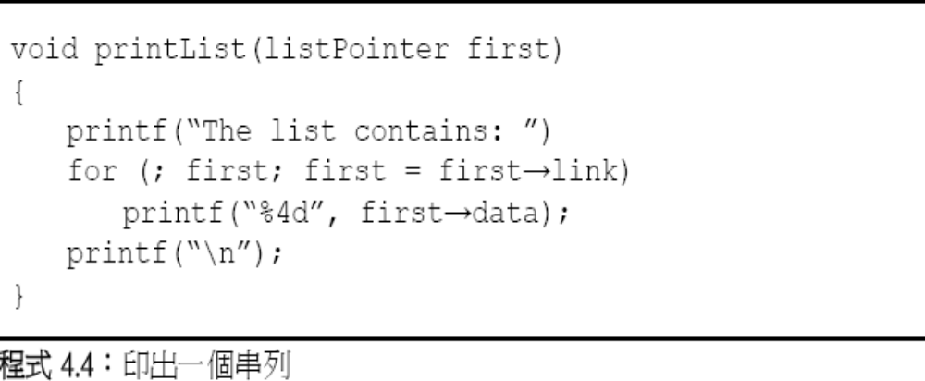
Linking list : print

Slide 14
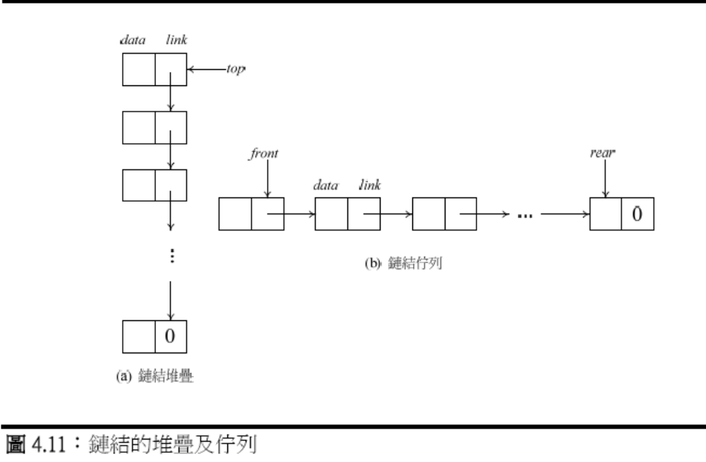
Linked stacks and Queues

Slide 15
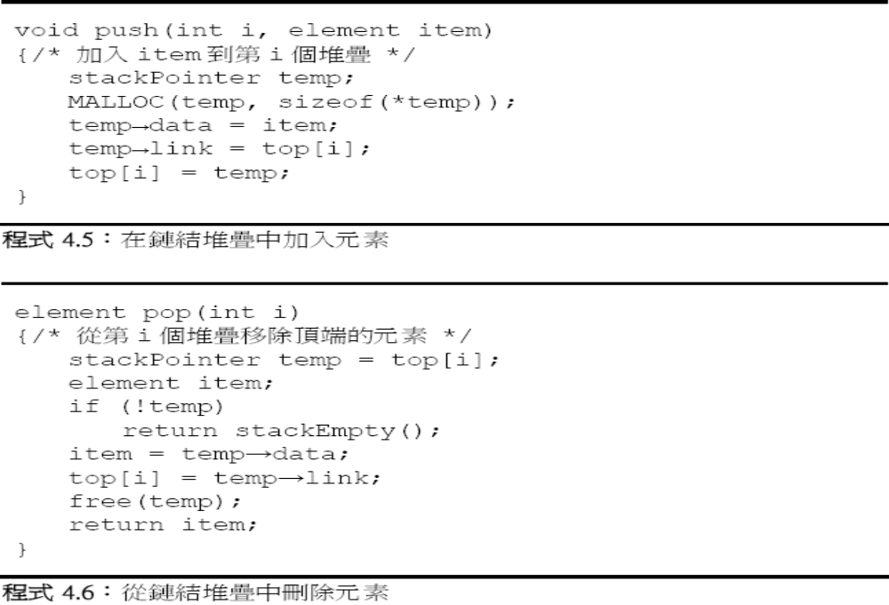
Linked stacks

Slide 16
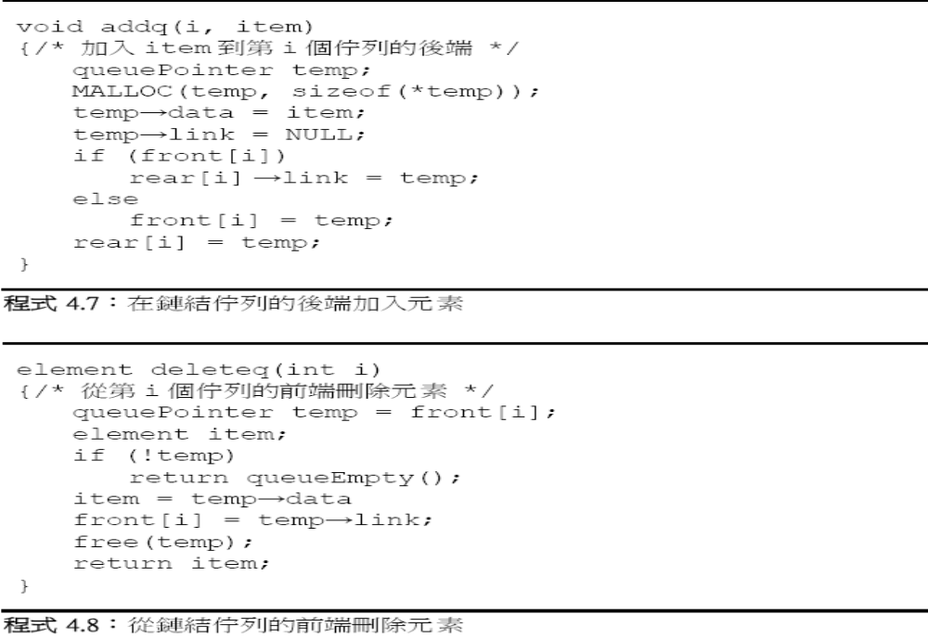
Linked Queues

Slide 17
Polynomials
Typedef struct polyNode *polyPointer;
Type struct polyNode{
  int coef;
  Int expon;
  polyPointer link;
  };
polyPointer a, b;

Slide 18
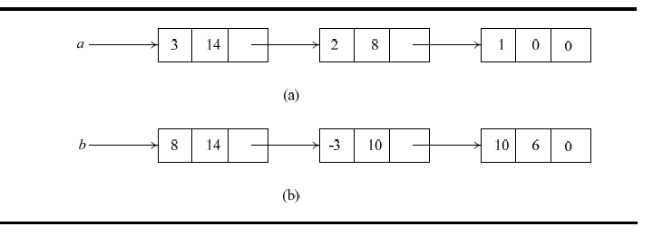
Polynomials

Slide 19
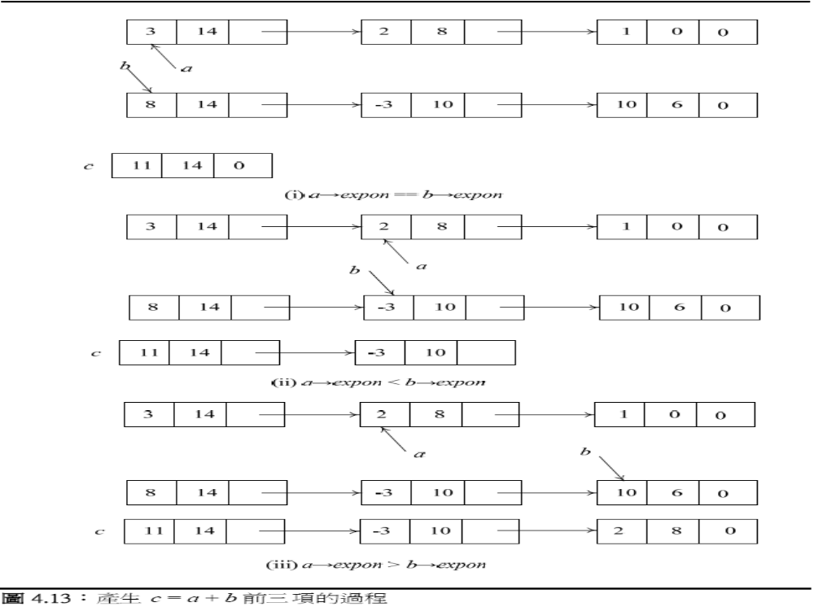
Polynomials: add

Slide 20
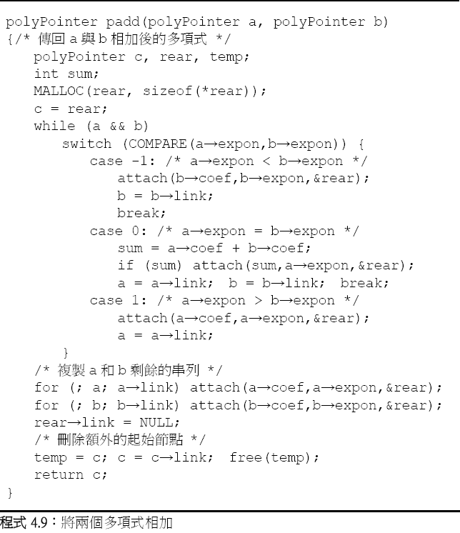
Polynomials: add

Slide 21
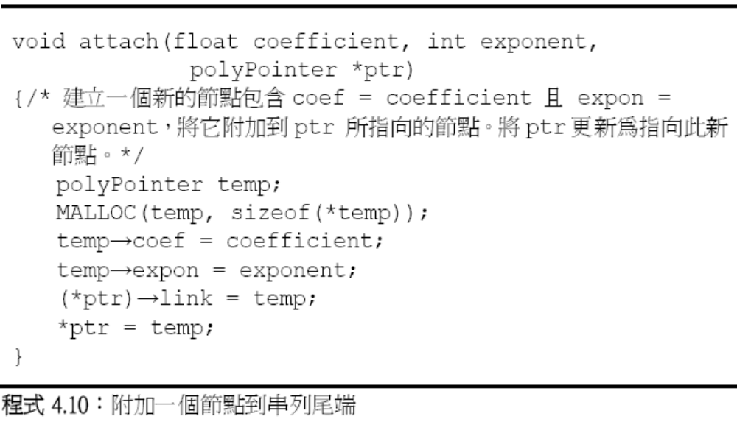
Polynomials: add

Slide 22
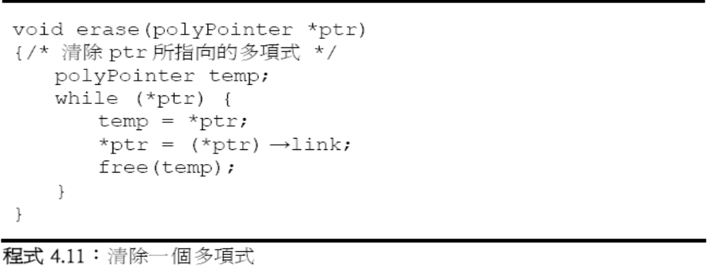
Polynomials: erasing

